Slide 1
Project Topic: Student Information System
Presented By:
Mayank Kashyap
MCA(LE) 5th Sem

Slide 2
Introduction
“Student Information System” manage the information about the students. Where Teacher can see or add student class, student information, set exam time table, and marks. There are two types of users available in the project, first one is Admin and second one is Teacher where admin users have full control over the system and teacher also have permission to deal with student record.

Slide 3
Problem Statement
In the existing system, here is a possibility that the same data in different registers may have different values which means the entries of the same data do not match.
User is no longer required to check his register in search of records. And it is very difficult to check the information about student or staff very quickly.
Solution
Due to many reasons, we create a system which can handled student & teacher information so that these difficulties can be decreases. So we can called this system Student Information System.

Slide 4
Functional Requirements
Add Details
Search
Delete
View
Database: mysql
Operating System: Windows

Slide 5
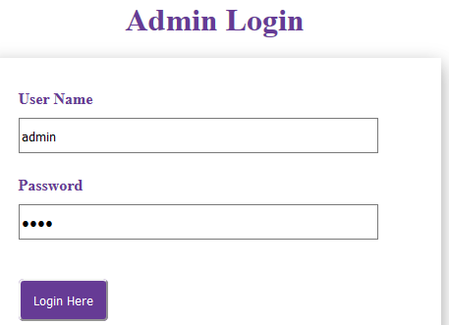
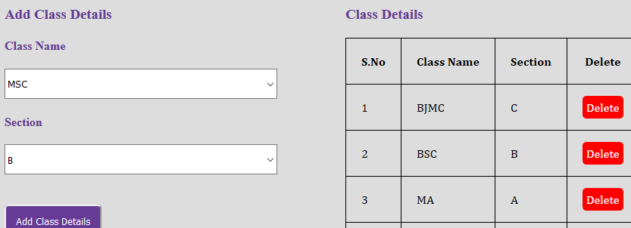
User Views
Administrator: Responsibility for managing student and teacher records.
Login into system
Add class

Slide 6
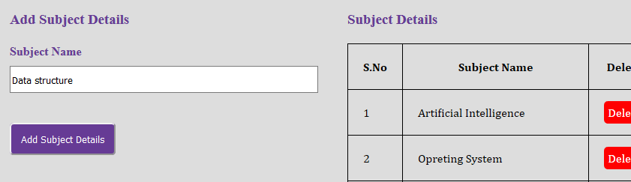
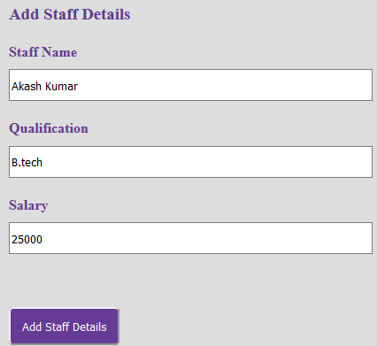
Add Subject
Staff

Slide 7
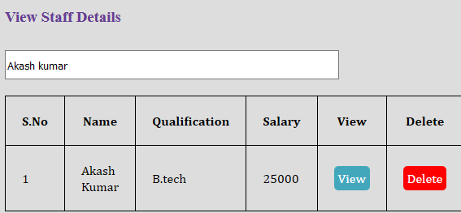
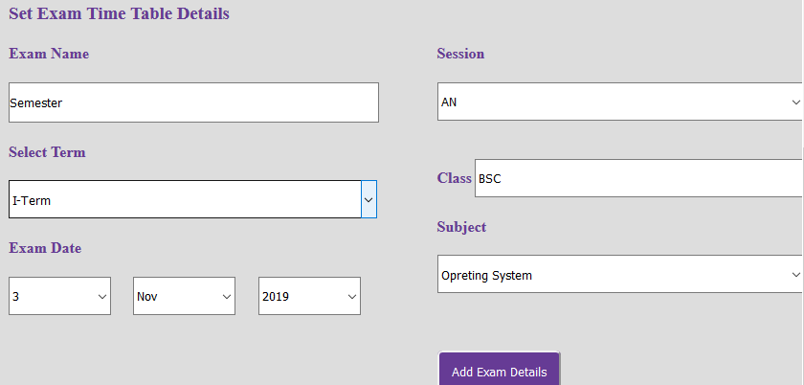
View staff
Set exam

Slide 8
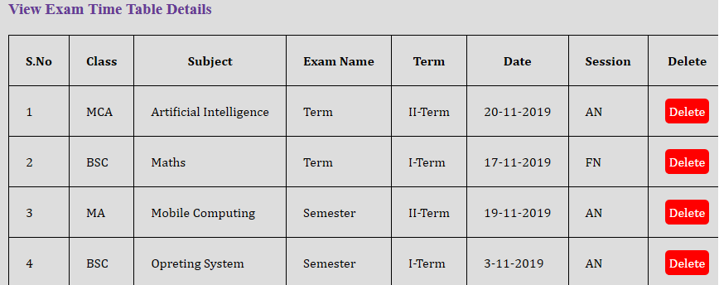
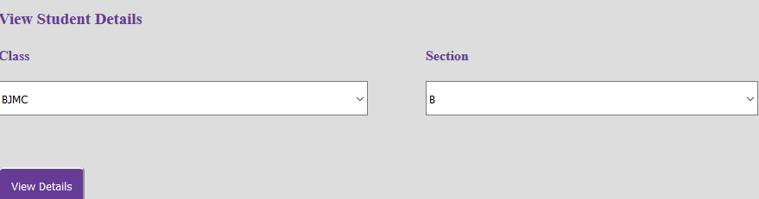
View exam
View student

Slide 9
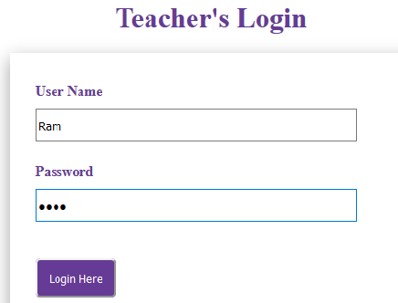
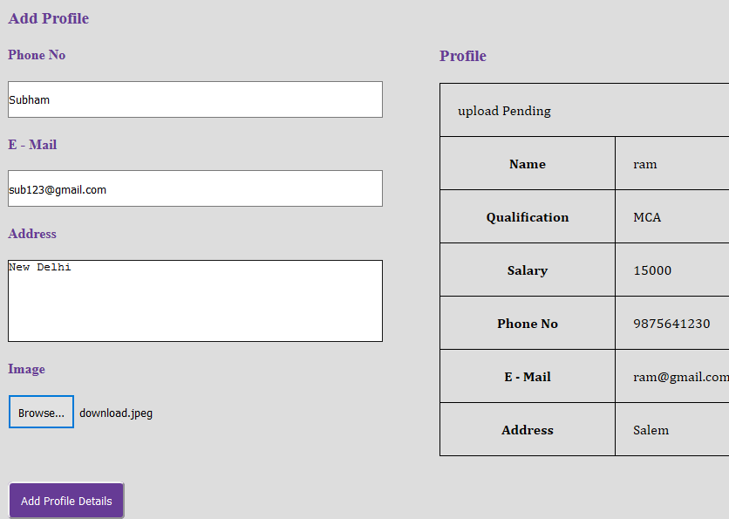
Teacher: Responsibility for managing student records.
Login into system
Add Profile

Slide 10
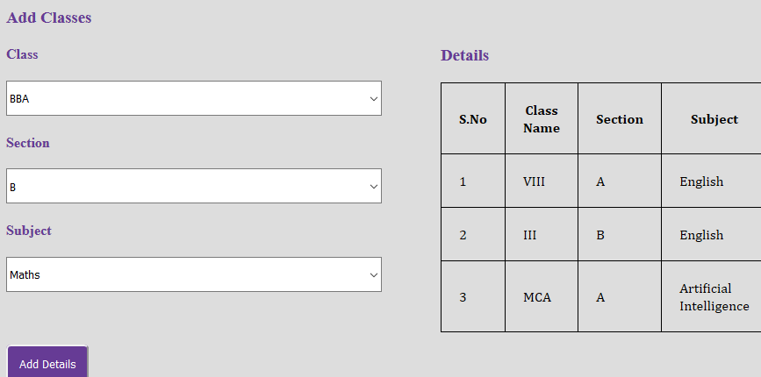
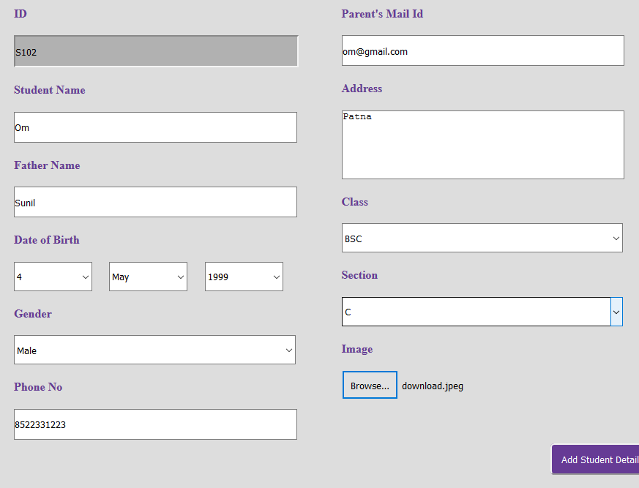
Handled class
Students

Slide 11
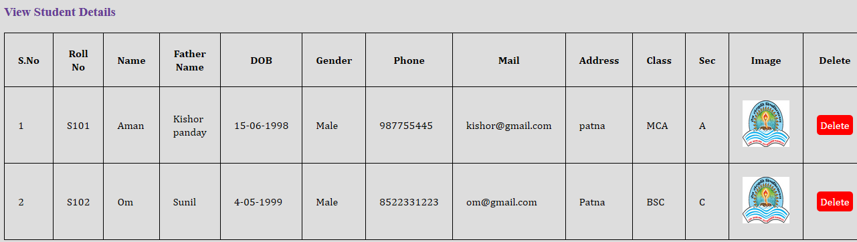
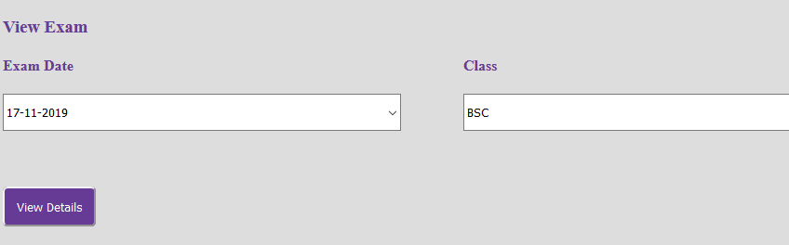
View students
View Exam

Slide 12
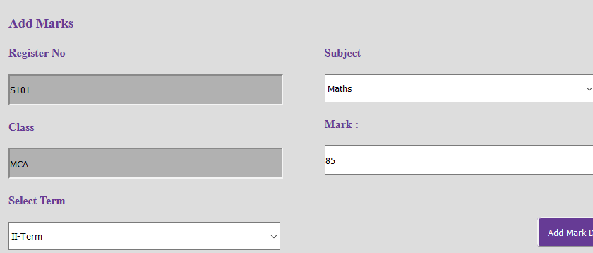


Add Marks
View Marks

Slide 13
Conclusion
The web site provides appropriate information to user according to the chosen service.
The project is designed keeping in view the problems.
Development of web site will help the teacher and admin to reduce unnecessary wastage of time in personally going to each department for some information.

Slide 14
Thank You!!!

